Slide 1




"Share your Data,_x000b_Keep your Secrets"
User Profile Management in Converged Networks (Episode II):_x000b_
Arnaud Sahuguet, Bogdan Alexe, Irini Fundulaki,
Pierre-Yves Lalilgand, Abdullatif Shikfa, Antoine Arnail

Slide 2
Key information for the audience
Lunch menu
  Salad (same dressing as always)
  Beans soup
  Dessert (leftovers from breakfast)
Beach information
  Water temperature cold, getting colder
  Skies cloudier and cloudier
Entertainment
  Ping-pong table booked all day by MIT enzyme guys
  Pool tables same
Bottom line
  Stay warm inside the chapel
  Food for thought vs food for stomach

Slide 3







Convergence, Convergence
Everything goes IP
End users have more and more devices
Each device potentially stores and manages a part of the end user profile
  Address book, presence, calendar, TV preferences, playlists, etc.
The network itself stores a lot of information
Converged applications need to have easy access to this user data.

Slide 4
The PIM Jungle (1)
Web Search engines
  Google, Yahoo!, MSN, A9, etc.
Personal search engines
  Google Desktop Search, X1, etc.
PIM clients
  Palm, Outlook, Mac suite, etc.
Web portals
  Yahoo!, MSN, .Mac, etc.
Semantic personal search engines
  Semex
Industry initiatives
  Passport (now defunct?)
  Liberty Alliance
  3GPP GUP

Slide 5
The PIM Jungle (2)
Why do I have to tell each e-commerce site when I change my address?
Why do I have to update my address book when my friends change their cell phone number?
Why can’t my colleagues access my business calendar when I am away?
Why can’t I have a unified address book for all my mail and web clients?

Slide 6
The PIM Jungle (3)
Various dimensions of the problem
  Data model
    XML, tabular, semi-structured, documents
  Locality
    Local vs distributed
  Static vs dynamic data
  Types of queries
    fulltext, data-mining-like semantic, etc.
  Interface
    Human
    Machine
  Ownership and privacy

Slide 7
Our Emphasis
Goal: provide a data management enabling technology for converged applications to share user profile information.
Single point of access to user profile information for converged applications
User profile in a broad sense
  Everything related to an end user worth sharing between two or more applications
  Agreed upon XML schema to describe user profiles
  Dynamic and static data
Data distribution
  Data scattered all across networks
  Data distribution for each user may be different
Strong emphasis on privacy
  End users can specify what parts of their profile can be accessed
Queries against user profiles are “simple”
  Think LDAP-like queries against the XML data model

Slide 8




The GUPster Difference
Application
All applications work with one protocol, one data format
End-users administer privacy controls at GUP^{ster} node only
Parlay, LDAP, etc.
SS7 / ASN.1
MS Exchange
or WebDAV / XML
Jabber / XML
HTTP / text or XML
Application
GUP^{ster}
Mobile
PSTN
Intranet
SOAP + XML
Each application must work with multiple protocols, data formats
End-users must administer privacy controls at each data source
Mediator
SOAP / XML
Mobile
PSTN
Intranet
Internet/Web

Slide 9
The GUPster Framework
GUPster = GUP + Napster
Napster
  community of users willing to share MP3 music files,
  administered by a central server managing meta-data about users and files.
  Goal = getting free from the music industry monopoly.
GUP^{ster}
  community of entities willing to share standardized GUP components,
  administered by a central server managing meta-data about entities and GUP components.
  Goal = creating synergies between network components.
GUPster = metadata server brokering queries to distributed data sources holding user profile data.

Slide 10


Possible Query Flow
GUPster : A privacy-conscious mediator
Application
2. GUPster enforces access
control policies
XML Schema
1. Bogdan asks for Arnaud’s
calendar and presence info
3. GUPster composes resulting
query with source descriptions
6. GUPster merges
results
4. Queries sent to
the sources
5. Results returned
to GUPster
Arnaud
Arnaud
Arnaud
Address book,
Calendar, Presence
Presence
Calendar, Presence

Slide 11
How do we do that elegantly, efficiently and securely?

Slide 12
A Key Observation
Storage problem = mapping parts of the user profile to data sources
Privacy problem = mapping parts of the user profile to true/false (modulo some context info)
“Simple query” problem = defining what parts of the user profile are to be returned
User profile = virtual XML document
“parts of the user profile” = sub-documents
Wouldn’t it be great to have a language to describe and reason about sub-documents.

Slide 13
One Language to Rule them all: XSquirrel
XPath 1.0 syntax with nested union
  top := p U p
  p := tag | p/p | p/(p U p) | p[q]
  q := label | p AND p | p OR p
Sub-document semantics
  Expand expression into set of XPath expressions
  Apply Xpath expressions -> nodeset
  Add descendants and ancestors
  Remove everything else
Composition operator
  Q1(Q2(D)) == Q1 • Q2 (D)

Slide 14
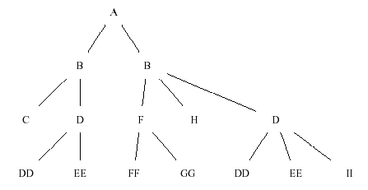
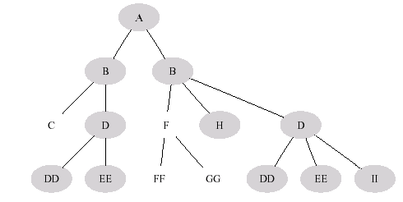
Simple Example
Query = /A/B/(D U H)
gets expanded into {/A/B/D, /A/B/H}

Slide 15
Query Composition
Q_{outer} = /A/(B[C] U B[H]/(D/II U F/FF))
Q_{inner} = /A/B[D/EE]/(D/DD U H U F)
Q_{outer} o Q_{inner} = /A/B[H][D/EE]/F/FF

Slide 16
Why another language
Because we can!
XPath 1.0
  Returns a nodeset (loses context of the original document)
  Non compositional
XQuery
  A hammer-gun to shoot you in the foot while trying to kill a fly
  Deconstruct a document with FLOWR and reconstruct it (and generates new nodes) while preserving the sub-document semantics
  Hard to have any guarantees
  Verbose
  XQuery on my cell phone anyone?
XSL-T
  Seriously ?
  Even more verbose

Slide 17
XQuery Example
Query /(A U B[p1] U C/D)
gets translated into something like
FOR $x1 in /*
RETURN
IF $x1[self::A] then { $x1 }
ELSE IF $x1[self::B[p1]][not(self::A)]
THEN { $x1 }
ELSE IF $x1[self::C[D]][not(self::A)][not(self::B[p1])]
THEN {
<C>
FOR $x4 IN $x1/* RETURN
IF $x4[self::D] THEN { $x4 } else ()
</C>
}
ELSE ()

Slide 18
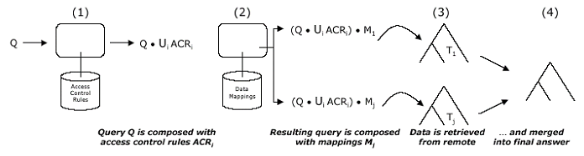
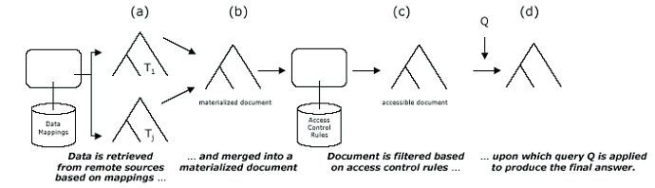
XSquirrel in Action
As opposed to the more traditional way …

Slide 19
Detailed Example
Bogdan’s query: /Gup/Contacts
Arnaud’s access control rules (positive) for Bogdan
/Gup/(Contacts/Entry[@type=“public”] U VoiceMail)
/Gup/Self/Identity
/Gup/Presence/JabberPresence 9am < t < 6pm
When you put them together (union)
/Gup/(Contacts/Entry[@type=“public”] U VoiceMail
U Self/Identity U Presence/JabberPresence)
When you compose with the query
/Gup/Contacts/Entry[@type=“public”]

Slide 20
Detailed Example (cont’d)
Arnaud’s data mappings
/Gup/Contacts/Entry[type=“private”]
/Gup/(Self U Contacts/Entry[@type=“public”])
We compose the visible query with each mapping
/Gup/Contacts/Entry[type=“private”][type=“public”]
/Gup/Self U Contacts/Entry[@type=“public”]
We send the queries and merge the results.
Merging is made easier because we have a global schema and we get back sub-documents.

Slide 21
System Implementation
Java prototype
Open source ingredients
  Axis, Tomcat, dbXML
Very compact code (XSquirrel makes things simple)
Web services everywhere
Numerous clients
  Mozilla
  J2ME
  Rich Internet applications
Numerous data sources
  MS Exchange, Voice mail, Corporate directory
  Jabber IM
  Location information via Parlay gateway
Demos (SIGMOD-04, VLDB-04, Lucent)

Slide 22
Architecture
Client
SOAP
Tomcat
GUPster server
Axis
GUPster provisioning
GUPster
service
GUPster mediators
SOAP
dbXML
Tomcat
Tomcat
Tomcat
Axis
Axis
Axis
GUPster
wrapper WS
GUPster
wrapper
WS
GUPster
wrapper
WS
Metadata
Backdoor
Provisioning
Client
Data source
Data source
Data source

Slide 23
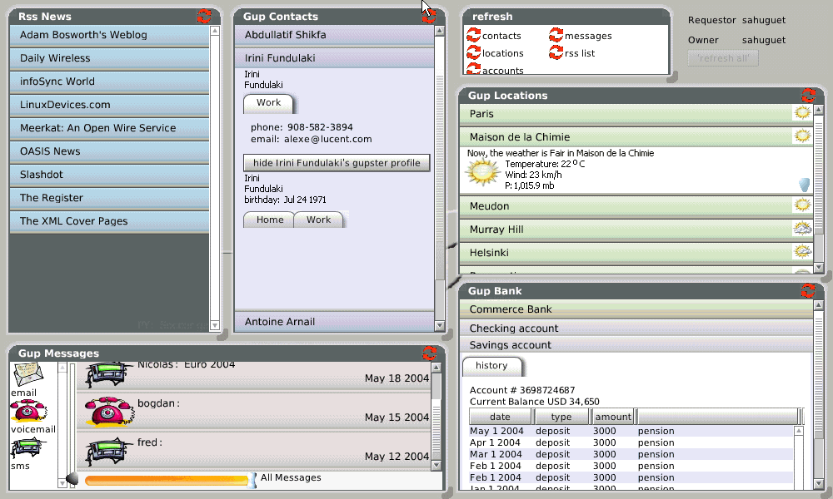
What can you do with it?

Slide 24
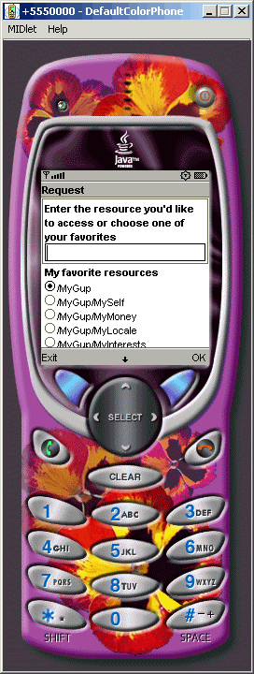
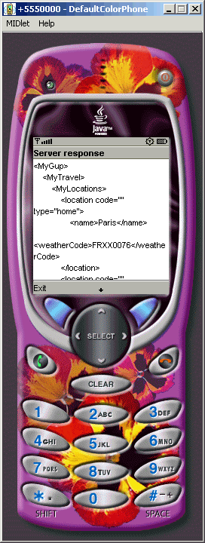
What can you do with it?
GUPster client implemented using J2ME
MIDlet suite
  To download certificate
  To interact with GUPster server securely
Tested live on Tungsten C

Slide 25


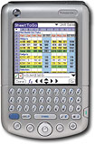
What can you do with it?
GUPster plug-in for JSyncManager
Computer (e.g. desktop)
running JSyncManager
Tomcat
Tomcat
Axis
GUPster
wrapper
WS
Axis
GUPster
service
Data Store
GUPster server

Slide 26
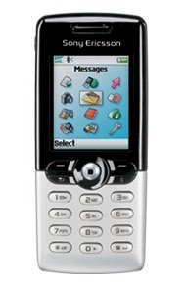


What can you do with it?
Tomcat
Tomcat
Axis
GUPster
wrapper
WS
Axis
GUPster
service
Data Store
GUPster server

Slide 27
A Few Words about Security
Identity management is a critical issue
  Access control is pointless if you cannot check the identity of the requestor (authentication)
Lots of competing solutions
  SAML, Liberty Alliance, Passport, etc.
We use x.509 certificates
  Proven technology (backbone of e-commerce security)
  Elegant solution (PKI), transparent for the application
CPU constraints of PKI seem OK
  Deployment on Tungsten C devices with pure Java SSL solution

Slide 28
A few words about Standards
GUPster ideas cannot live without standards
  Standardized interfaces
  Standardized schemas
GUPster started with 3GPP GUP work
GUP to be aligned with Liberty Alliance
  Interesting exercise for data management & security, given that Lucent is not part of LA
XSquirrel as a standard (Why not?)
  Sibling of XPath
  Macro language with translation to XSLT and XQuery
XSquirrel, GUPster open source?
  Send email to hull@lucent.com :-)

Slide 29
Related Work
XML data integration
  Local as view
  Nothing really new here except that mapping is on a per user basis
Privacy
  Static access control
  Policies are user defined (as opposed to Hippocratic DB)
What is new is to combine both integration and privacy in the same framework.
PIM management
  Semex, Haystack, Palm, Outlook, etc.
Web services identity management
  Liberty Alliance

Slide 30
Future Work
XSquirrel
  Standardization
  Theoretical studies
  Evaluation (translation vs native evaluation)
Updates
Synchronization
Identity Management
  A special case of “data reconciliation”
  “Identity as identity” vs “identity as data” (e.g. buddy list)
Password management
Actual deployment
  Who should host the GUP server (trust issue)
  Convincing people to share their data (incentives)
  Interaction with tools like Semex, Haystack

Slide 31
Conclusions
Privacy conscious data sharing is cool
Not clear there is a market for it though
  Like Napster, we may fail but for a different reason
Nevertheless, we had to invent XSquirrel in order to solve the problem
  Missing link when you think about it
  Interesting language with probably broader potential
  Lots of theoretical problems around it
The important thing is not the destination,
it is the journey.

